Slide 1
Plan for today
“Open up” the calculator with
Two (intertwined) discussions: π^{cos(1.2 radians)}… what does it mean? Graphs in the TI 84

Slide 2
Start with integer powers
Define (positive) integer powers.
Use the recursive definition of integer powers to write down a program to compute integer powers in the calculator.
Food for thought
Integer powers are to multiplication by integers, as multiplication by integers is to addition.

Slide 3
In 1626, Peter Minuet bought the island of Manhattan to native Americans for trinkets valued at $24.
Suppose those $24 were invested at 8% annual. What would their $24 be worth today?
Compute with our own program and with the calculator program. Time both results and compare.

Slide 4
Positive integer powers
Use this program to compute the “price of Manhattan” and compare the timing with the first program we discussed.
Prompt B,E
1->P
While E>0
E – 2 * int(E/2)->R
If R=1
P*B->P
B*B->B
int(E/2)->E
End
Disp P
Write down a table following the values of B, E, P and R in the following situations
Before the while loop.
After the first pass on the while loop.
After the second pass on the while loop and so on until the value E=0 is reached.

Slide 5
Graph in your calculator y=(1+x)^{1/x}
Is the graph you obtained the graph of a function?
If so, what is the domain?
Consider the points on the graph on the left side of the line x=-1. Can you find the coordinates of those points?
Can explain the graph?

Slide 6
To display a table in the TI 84
Make sure that the equal sign in the Y= of your function is highlighted.
Press 2nd-Window to get to the Table Set Up Menu.
Choose the appropriate values for your table.
Make sure that Auto is highlighted in Indepnt and Depend
Press 2nd Graph to display the table.

Slide 7
Integer powers (positive or negative exponents)
Modify the positive integer powers program to compute also non-negative powers of positive numbers.

Slide 8
Non-integer powers
Write down 0.714 in base 2.
Use 1. to compute 3^{0.714} in your TI 84 using only the square root and product keys.

Slide 9
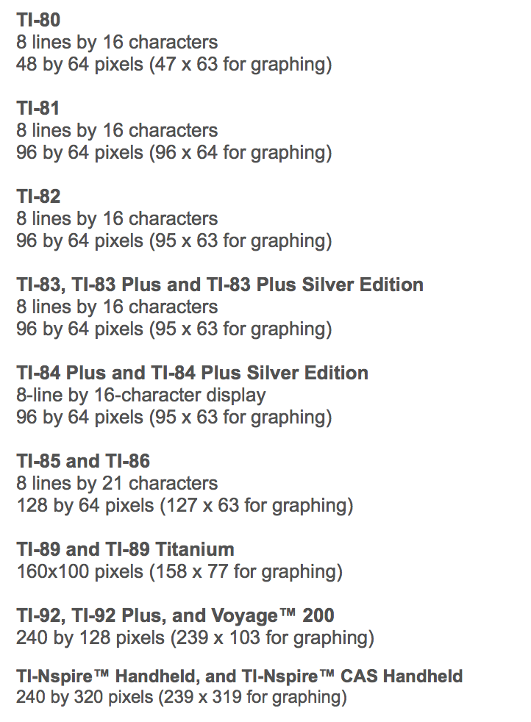

Slide 10
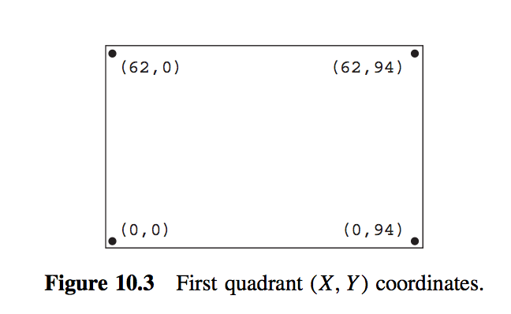
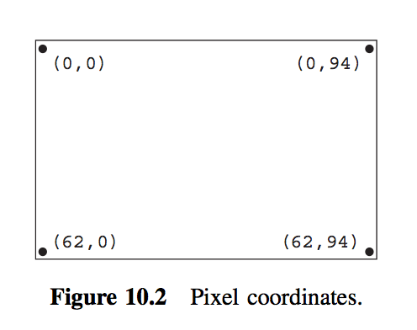

Slide 11
Design a program that draws a line (any line!) on your calculator using Pxl-On and a For-loop.

Slide 12
Log(385) ~2.585
Log(38.5)~1.585
Log(3.85)~0.585
Long(0.385) ~ ?

